Slide 1

COMM223 Marketing Management
Lecture 1 – Introduction

Slide 2
Agenda
Introduction
Overview of textbook & course outline
Chapter 1: what is marketing?
Definition of marketing
5 steps of marketing process

Slide 3
Introduction
Instructor: Tieshan Li
Phone: 514-848-2424 ext 2953
Office: MB13-315
Office hour: 14:30 to 15:30 on Thursday or by appointment
E-mail: tieshan.li@concordia.ca

Slide 4
Course Description
Get to know the definition and domain of Marketing
Analyze marketing questions
Develop Marketing Plan

Slide 5
A Framework for Marketing Management
Company
Company Analysis
Competitor Analysis
Consumer Analysis
Marketing Management
Competitor
Consumer
Product
Promotion
Price
Distribution
Product - Market

Slide 6
Textbook
Marketing An Introduction
7th Canadian Edition
By Armstrong, Kotler, Trifts, and Buchwitz

Slide 7
Pedagogy
lectures
class discussion
video presentations
group-work

Slide 8
Grading
Marketing Research Practicum 4%
Quiz 1 (Class 4) 8%
Quiz 2 (Class 11) 8%
Mid-term (Class 7) 25%
Team Project (Class 13) 25%
Final Exam 30%
Total 100%

Slide 9
Team Project
Forming group (6 members each group)
Start as early as possible
Peer evaluation

Slide 10
Why Study Marketing?
Because firms ultimately exist to serve customers and compete in the market
Hence all functional areas need to understand marketing needs
Marketing is an important component of a business strategy
About 50% of total product costs are marketing costs
Career – about 25% to 33% of the work force hold marketing positions

Slide 11
What is marketing?
Marketing is about engaging customers and managing profitable customer relationships
Attracting new customers
Retaining and growing current customers
Marketing Defined:
“the process by which companies engage customers, build strong customer relationships, and create customer value in order to capture value from customers in return”
Notes:
Bank, telephone industry – switching cost

Slide 12
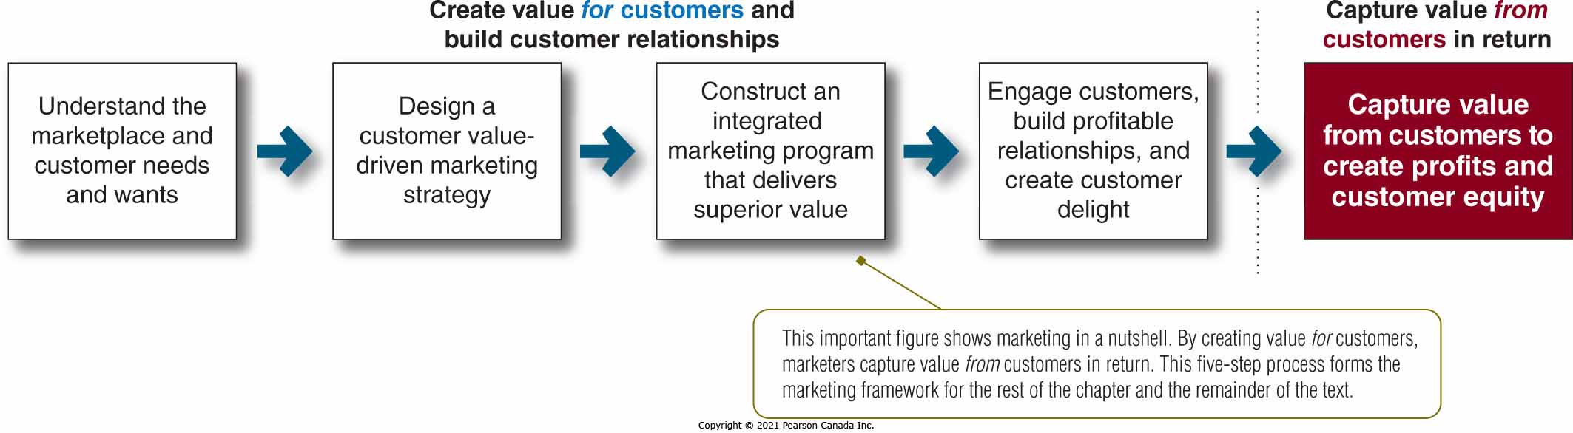
The Marketing Process

Slide 13
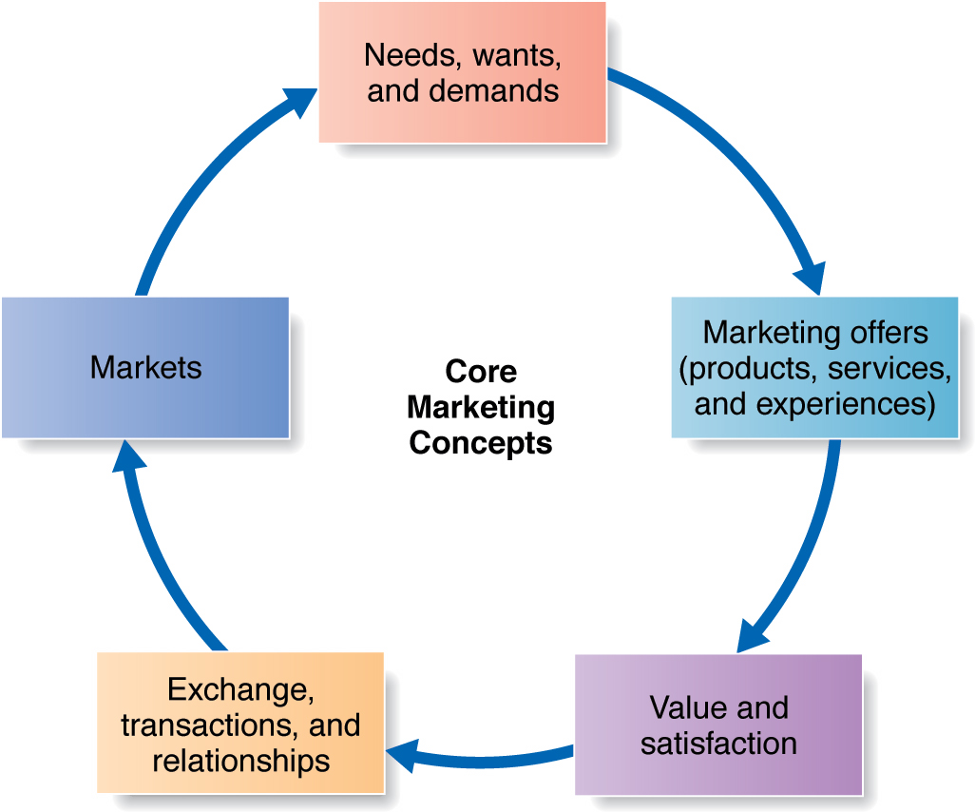
Step 1: Understanding the Marketplace

Slide 14
Step 1: Understanding the Marketplace
Core Concepts
Needs
State of felt deprivation; include physical /social/individual needs
Not created by marketers
E.g. I am thirsty
Wants
The form of needs as shaped by culture and the individual
E.g. I am thirsty, so I want coke.
Demands
Wants which are backed by buying power
I have money to buy coke
Needs, wants, and demands
Marketing offers: including products, services and experiences
Value and satisfaction
Exchange, transactions and relationships
Markets

Slide 15
Step 1: Understanding the Marketplace
Core Concepts
Marketing offer
Combination of products, services, information or experiences that satisfy a need or want
Should focus on providing a solution
Needs, wants, and demands
Marketing offers: including products, services and experiences
Value and satisfaction
Exchange, transactions and relationships
Markets

Slide 16
Step 1: Understanding the Marketplace
Core Concepts
Value
Customers form expectations regarding value
Marketers must deliver value to consumers
Satisfaction
A satisfied customer will buy again and tell others about their good experience
Needs, wants, and demands
Marketing offers: including products, services and experiences
Value and satisfaction
Exchange, transactions and relationships
Markets

Slide 17
Step 1: Understanding the Marketplace
Core Concepts
Exchange
The act of obtaining a desired object from someone by offering something in return
One exchange is not the goal, relationships with several exchanges are the goal
Needs, wants, and demands
Marketing offers: including products, services and experiences
Value and satisfaction
Exchange, transactions and relationships
Markets

Slide 18
Step 1: Understanding the Marketplace
Core Concepts
Market
Set of actual and potential buyers of a product
Marketers seek buyers that are profitable
Needs, wants, and demands
Marketing offers: including products, services and experiences
Value and satisfaction
Exchange, transactions and relationships
Markets

Slide 19
Step 2: Designing a Customer-Driven Marketing Strategy
Marketing management is “the art and science of choosing target markets and building profitable relationships with them.”

Slide 20
Step 2: Designing a Customer-Driven Marketing Strategy a winning marketing strategy
What customers will we serve?
Market segmentation and target marketing
Marketers select customers that can be served profitably
How can we serve these customers best?
By defining a value proposition that will differentiate and position the brand in the marketplace
Is set of benefits or values a company promises to deliver to consumers in order to satisfy their needs

Slide 21
Step 2: Designing a Customer-Driven Marketing Strategy Marketing Management Orientations
Production Concept
Consumers will favor available/affordable products
Focus on improving production/distribution efficiency
Still useful when demand exceeds supply
Product Concept
Consumers favor products with the best:
Quality
Performance
Features
Focus on continuous product improvements

Slide 22
Step 2: Designing a Customer-Driven Marketing Strategy Marketing Management Orientations
Selling concept:
Products need large-scale selling/promotion effort
Focus on the hard sell
Unsought goods, or when company has overcapacity

Slide 23
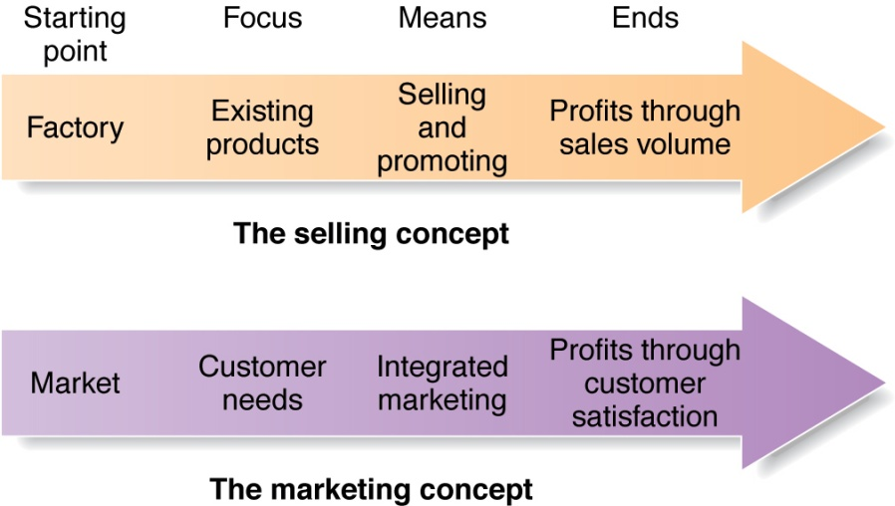
Step 2: Designing a Customer-Driven Marketing Strategy Marketing Management Orientations
The marketing concept:
Achieve organizational objectives by
Determining needs and wants of target consumers
Delivering satisfaction
Better than competitors

Slide 24
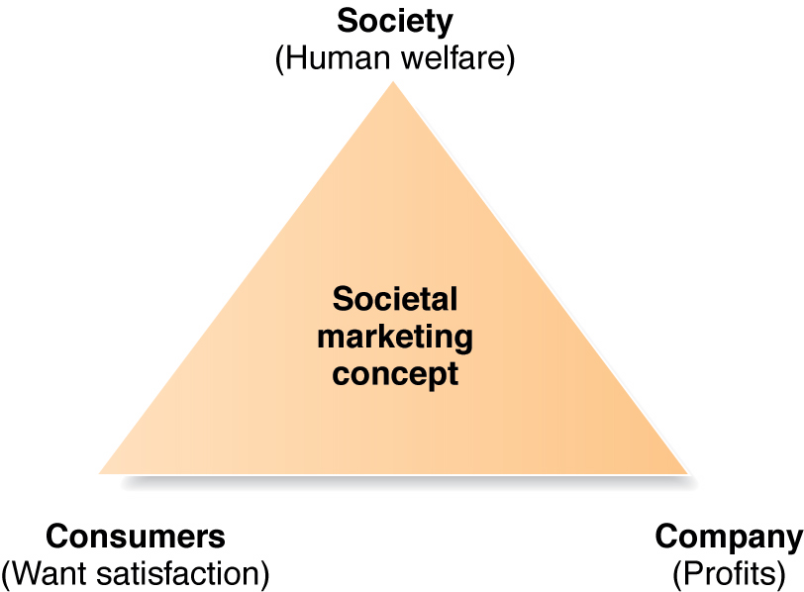
Step 2: Designing a Customer-Driven Marketing Strategy Marketing Management Orientations
The Societal Marketing Concept
Consumer’s wants
Company’s requirement
Consumer’s long-run interest
Society’s long-run interest

Slide 25
Step 3: Preparing a Marketing Plan and Program
Build customer relationships by transforming the marketing strategy into action
Includes the marketing mix and the 4Ps of marketing
Product
Price
Place
Promotion

Slide 26

Step 4: Building Customer Relationships
CRM – Customer relationship management . . . “is the overall process of building and maintaining profitable customer relationships by delivering superior customer value and satisfaction. It deals with all aspects of acquiring, keeping and growing customers.”

Slide 27
Step 4: Building Customer Relationships Relationship Building Blocks: Value and satisfaction
Customer Perceived Value
The customers’ evaluation of the difference between benefits and costs.
Customers often do not judge values and costs accurately or objectively.
Customer Satisfaction
Product’s perceived performance relative to customers’ expectations.

Slide 28
Step 4: Building Customer Relationships Customer Relationship Levels and Tools
Basic relationships
low margin customers
Full partnerships
key customers
Frequency marketing programs
Reward customers who buy frequently or in large amounts
Club marketing programs
Offer members special discounts and create member communities

Slide 29
Step 4: Building Customer Relationships Partnership Relationship Management
Working closely with partners in other company departments and outside the company to jointly bring greater value to customers
Partners Inside the Company
Partners Outside the Firm
Strategic partners
Supply chain management

Slide 30
Step 5: Capturing Value from Customers
Creating Customer Loyalty and Retention
Customer delight leads to emotional relationships and loyalty
Customer lifetime value shows true worth of a customer
Growing Share of Customer
The portion of the customer’s purchasing that a company gets in its product categories.
Achieved through offering greater variety, cross-sell and up-sell strategies

Slide 31
Step 5: Capturing Value from Customers customer equity
Building Customer Equity
The combined customer lifetime values of all current and potential customers
Measures a firm’s performance, but in a manner that looks to the future
Choosing the “best” customers is key

Slide 32
Step 5: Capturing Value from Customers customer equity
Customer equity vs. Market share
Market share: Measurement of past/current performance
Customer equity: Measurement of future performance
Cadillac vs. BMW in 70s and 80s
Cadillac:
Higher market share & “North American Luxury”
Brand image was old & traditional → Couldn’t attract young buyers → Customer equity was falling as time goes on
BMW:
Lower market share, but “youthful & vigorous” image
Could attract younger buyers → Higher customer equity

Slide 33
What is marketing?
The process of building profitable customer relationships by creating value for customers and capturing value in return

Slide 34
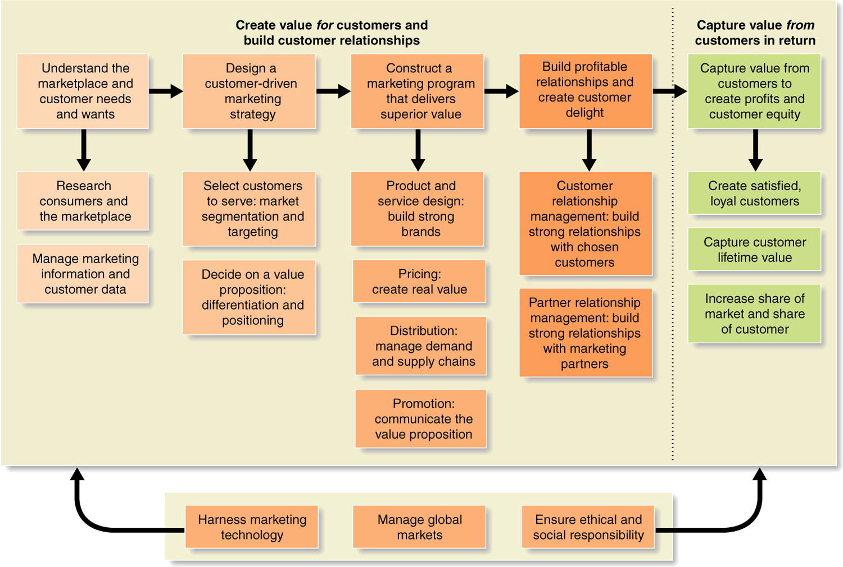
Expanded model of marketing process

Slide 35
Read Chapters 2 & 3

